Slide 1
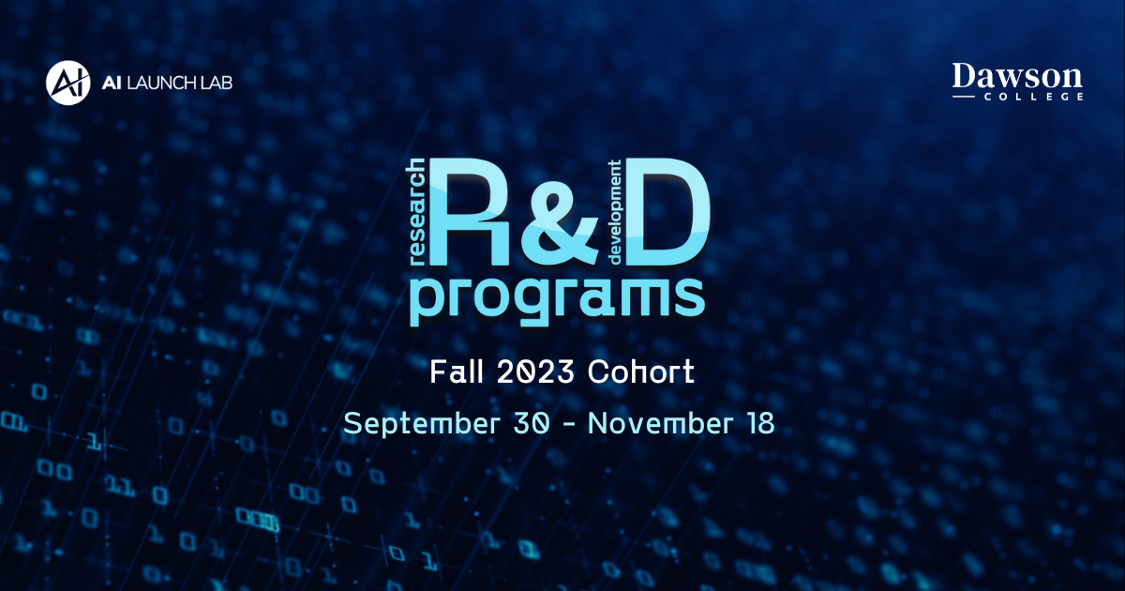

Slide 2

Fall Cohort
Engage with Large Language Models (LLMs) such as ChatGPT to gain an understanding of their capabilities, limitations, and risks, while exploring how they can be used as an assistant to apply AI for practical applications

Slide 3
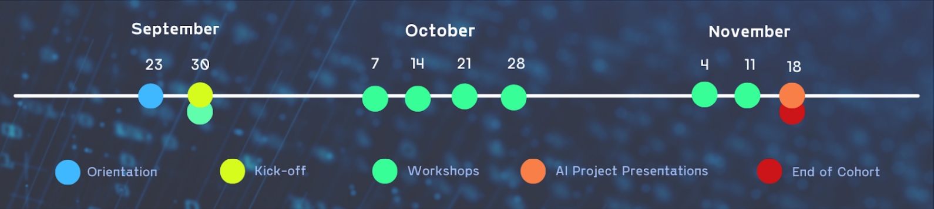
Timeline

Slide 4

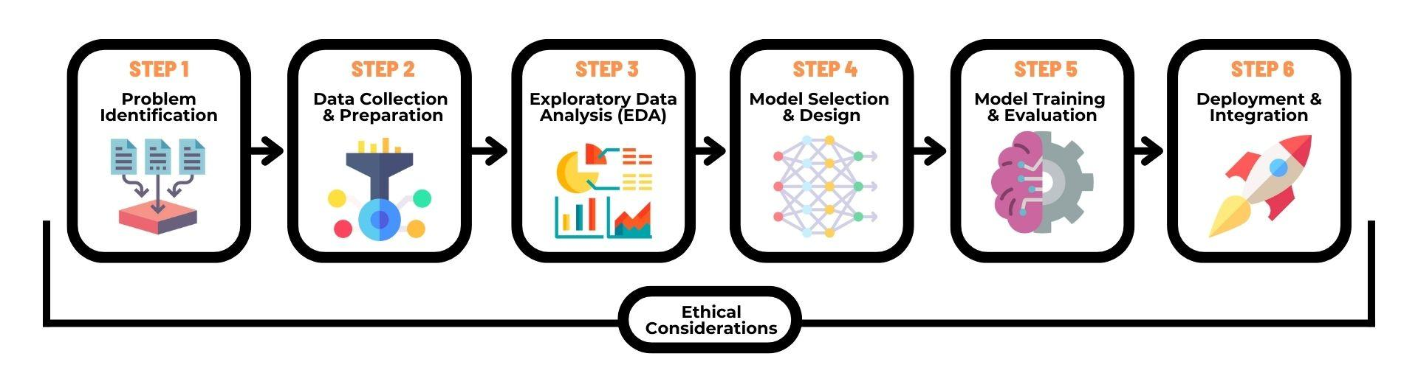
AI Project Blueprint
AI Project Blueprint is a guide outlining the key steps and considerations for implementing an AI solution to address a problem
Notes:
For this cohort, you will work on creating an AI Project Blueprint in teams of 3 - 4.
Within the context of this program, an AI Project Blueprint is defined as a deliverable outlining the key steps and considerations for an AI project. It can serve as a guide for planning and implementation of an AI solution that addresses a problem or meets specific objectives.
Your team’s Blueprint can be in the format of a document, webpage, Github Repo, Jupyter Notebook/Book, etc. In the last week of the program, you will be asked to present your project to everyone.
[Cohort Book]
If your team would like to implement the project or parts of the project, you are welcome to. During the program, you will learn how to make use of ChatGPT or HuggingChat as a mentor and assistant while learning to program and/or improve your programming skills. You can use those skills to implement the project and we can assist you along the way.
Step 1: Problem Identification and Scope [Week 3]
In this step, your primary goal is to define the problem you want to solve, understanding the current state, and envisioning the ideal state once the AI solution is implemented. Consider the following:
Problem Definition: Clearly identify the problem statement you want to solve.
Target Audience: Identify who will benefit from your AI solution and any other stakeholders involved.
Scope and Constraints: Determine the boundaries of your project and any limitations.
Success Criteria: Document what success looks like, including specific metrics or outcomes to measure.
Step 2: Data Collection and Preparation [Week 3/4]
Data is instrumental for the success of an AI project. Consider the following:
Data Sources: Identify where you can obtain relevant data.
Collection Method: Choose how you will collect data (e.g., web scraping, APIs, manual collection).
Data Attributes: Document the specific features or attributes you need for your AI model.
Data Cleaning: Explain how you will handle missing values, outliers, and inconsistencies. Split your data into training, validation, and testing sets for model development.
Step 3: Exploratory Data Analysis (EDA) [Week 4]
EDA is all about understanding your data better. Consider the following:
Descriptive Statistics: Describe the importance of statistics in understanding your data.
Data Visualization: Explain the role of graphs, charts, and plots in visualizing data.
Pattern Identification: Discuss the process of identifying patterns, trends, or correlations within the data.
Data-Driven Decisions: Explain how EDA helps in making data-driven decisions for subsequent steps.
Step 4: Model Selection and Design [Week 5]
For this step, you will be focused on identifying a model to use and what it may look like. Consider the following:
Model Research: Research and select the most suitable model or algorithm for your problem and data.
Model Architecture: Define the structure and parameters of your chosen model.
Optimizations: Consider any necessary tweaks or customizations to improve model performance.
Rationale: Document why you selected this particular model and design choices.
Step 5: Model Training and Evaluation [Week 6]
In this step, focus on how you train and assess your model. Consider the following:
Training Process: Explain the process of training your model using the prepared training data.
Fine-Tuning: Discuss the concept of fine-tuning based on performance evaluations.
Metrics: Emphasize the importance of using appropriate metrics (accuracy, precision, recall, etc.) to evaluate your model.
Validation: Stress the significance of validating your model with separate validation data to ensure it generalizes well.
Iteration: How would you perform iterative refinement based on evaluation results?
Step 6: Deployment and Integration [Week 7]
For this step, think about getting your model into the real world. Consider the following:
Deployment Preparation: Discuss considerations for deploying your model (web, mobile, embedded systems, etc.).
Real-World Testing: Emphasize testing the deployed model with real-world data to ensure it performs as expected.
Monitoring and Evaluation: Explain the importance of ongoing performance monitoring and evaluation.
Maintenance and Updates: Provide instructions for maintaining, updating, and improving your deployed model.
Reflection: Reflect on your initial Problem Identification and Scope to ensure your AI solution still aligns with your original goals.
Ethics Considerations [Weeks 5 - 7]
Apply concepts learned during the Ethics workshops to each step of the AI Project Pipeline

Slide 5





Project Selection and Development
Think of problems in these areas and how AI could be used to address them
Climate Change
Healthcare
Education
Humanitarian Aid
Finance
Notes:
Climate Action:
Applying AI techniques to address climate change and its impact on the environment, such as predicting and mitigating natural disasters or optimizing energy consumption. Example AI project: Developing a deep learning model to analyze satellite imagery and detect deforestation patterns in real-time, enabling timely intervention and conservation efforts
Healthcare:
Utilizing AI to improve healthcare services, improve diagnosis, facilitate personalized medicine, all for better patient outcomes. Example AI project: Creating an AI-powered diagnostic tool that uses machine learning algorithms to analyze medical images and assist radiologists in early detection of cancerous tumors.
Education:
Leveraging AI to enhance learning experiences and personalize education. Example AI project: Building a chatbot-based virtual assistant that uses natural language processing and machine learning to provide information about critical topics like government policies, how to take care of yourself healthwise, and answer student questions.
Humanitarian Aid:
Employing AI technologies to support disaster response and optimize resource allocation in emergency situations. Example AI project: Developing an AI-driven system that analyzes social media data to identify critical information during natural disasters, enabling rapid response and coordination among relief organizations.
Finance:
Leveraging AI to enhance financial services, risk assessment, fraud detection, and improve investment decisions. Example AI project: Creating a predictive analytics model that uses machine learning to forecast market trends, helping investors make informed decisions and optimize portfolios.
Think of problems in these areas and how AI could be used to solve them
Come prepared for the first session with ideas in mind and ready for discussion
If you come from a specific domain, think of problems in that domain and try searching if AI has been applied to that or not
There are many resources for a wide audience to get a better understanding of recent AI developments
Think of things you are passionate about within these topics and what can be improve pain points
You can use the AI Launch Lab Discord to chat with your peers about shared interests and you’ll also have some time to discuss in the first session
More details about the Project is to come soon

Slide 6
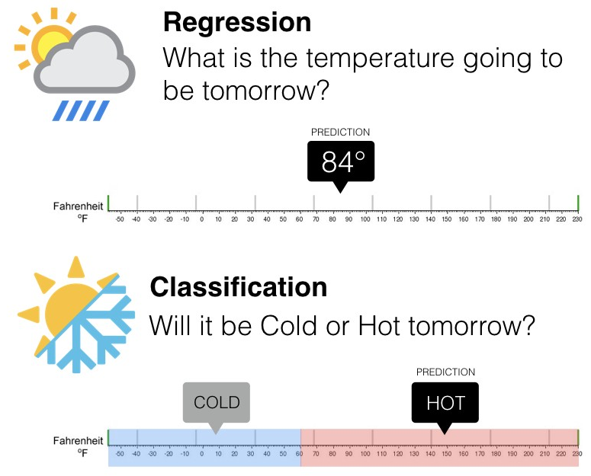
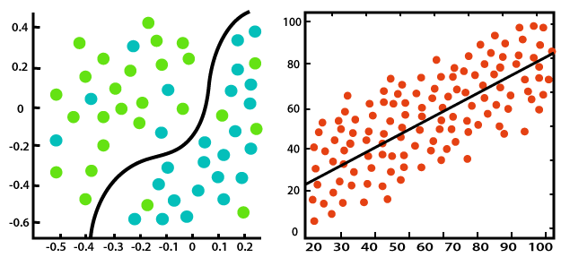
Project Structure - Regression/Classification
Classification
Regression
Notes:
Focus on projects that do one of 2 fundamental learning tasks. You will learn more about them in the coming weeks. But to give you a sneak peak,
Classification involves categorizing data into predefined classes or categories. So, the input has to fall under one of these categories. Common examples include will it be hot or cold tomorrow, spam detection (spam or not spam), sentiment analysis (positive, negative, or neutral), and medical diagnosis (presence or absence of a disease).
Regression involves predicting a continuous output or numerical value. Common examples of regression tasks include predicting what the temperature will be tomorrow, predicting house prices, stock prices, temperature, or any other quantitative measurement.

Slide 7
Notes:
For this cohort, you will work on creating an AI Project Blueprint in teams of 3 - 5.
Within the context of this program, an AI Project Blueprint is defined as a deliverable outlining the key steps and considerations for an AI project. It can serve as a guide for planning and implementation of an AI solution that addresses a problem or meets specific objectives.
Your team’s Blueprint can be in the format of a document, webpage, Github Repo, Jupyter Notebook/Book, etc. In the last week of the program, you will be asked to present your project to everyone.
[Cohort Book]
If your team would like to implement the project or parts of the project, you are welcome to. During the program, you will learn how to make use of ChatGPT or HuggingChat as a mentor and assistant while learning to program and/or improve your programming skills. You can use those skills to implement the project and we can assist you along the way.
Step 1: Problem Identification and Scope [Week 3]
In this step, your primary goal is to define the problem you want to solve, understanding the current state, and envisioning the ideal state once the AI solution is implemented. Consider the following:
Problem Definition: Clearly identify the problem statement you want to solve.
Target Audience: Identify who will benefit from your AI solution and any other stakeholders involved.
Scope and Constraints: Determine the boundaries of your project and any limitations.
Success Criteria: Document what success looks like, including specific metrics or outcomes to measure.
Step 2: Data Collection and Preparation [Week 3/4]
Data is instrumental for the success of an AI project. Consider the following:
Data Sources: Identify where you can obtain relevant data.
Collection Method: Choose how you will collect data (e.g., web scraping, APIs, manual collection).
Data Attributes: Document the specific features or attributes you need for your AI model.
Data Cleaning: Explain how you will handle missing values, outliers, and inconsistencies. Split your data into training, validation, and testing sets for model development.
Step 3: Exploratory Data Analysis (EDA) [Week 4]
EDA is all about understanding your data better. Consider the following:
Descriptive Statistics: Describe the importance of statistics in understanding your data.
Data Visualization: Explain the role of graphs, charts, and plots in visualizing data.
Pattern Identification: Discuss the process of identifying patterns, trends, or correlations within the data.
Data-Driven Decisions: Explain how EDA helps in making data-driven decisions for subsequent steps.
Step 4: Model Selection and Design [Week 5]
For this step, you will be focused on identifying a model to use and what it may look like. Consider the following:
Model Research: Research and select the most suitable model or algorithm for your problem and data.
Model Architecture: Define the structure and parameters of your chosen model.
Optimizations: Consider any necessary tweaks or customizations to improve model performance.
Rationale: Document why you selected this particular model and design choices.
Step 5: Model Training and Evaluation [Week 6]
In this step, focus on how you train and assess your model. Consider the following:
Training Process: Explain the process of training your model using the prepared training data.
Fine-Tuning: Discuss the concept of fine-tuning based on performance evaluations.
Metrics: Emphasize the importance of using appropriate metrics (accuracy, precision, recall, etc.) to evaluate your model.
Validation: Stress the significance of validating your model with separate validation data to ensure it generalizes well.
Iteration: How would you perform iterative refinement based on evaluation results?
Step 6: Deployment and Integration [Week 7]
For this step, think about getting your model into the real world. Consider the following:
Deployment Preparation: Discuss considerations for deploying your model (web, mobile, embedded systems, etc.).
Real-World Testing: Emphasize testing the deployed model with real-world data to ensure it performs as expected.
Monitoring and Evaluation: Explain the importance of ongoing performance monitoring and evaluation.
Maintenance and Updates: Provide instructions for maintaining, updating, and improving your deployed model.
Reflection: Reflect on your initial Problem Identification and Scope to ensure your AI solution still aligns with your original goals.
Ethics Considerations [Weeks 5 - 7]
Apply concepts learned during the Ethics workshops to each step of the AI Project Pipeline

Slide 8
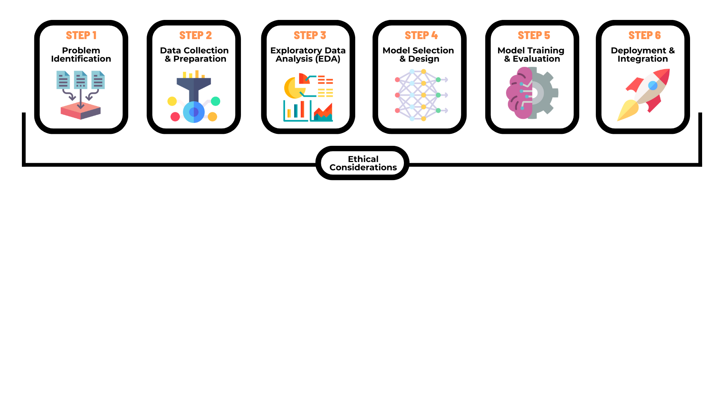

Slide 9
Problem Definition Clearly identify the problem statement you want to solve
Target Audience Identify who will benefit from your AI solution and any other stakeholders involved
Scope and Constraints Determine the boundaries of your project and any limitations
Success Criteria Document what success looks like, including specific metrics or outcomes to measure
Notes:
Focus on projects that do one of 2 fundamental learning tasks. You will learn more about them in the coming weeks. But to give you a sneak peak,
Classification involves categorizing data into predefined classes or categories. So, the input has to fall under one of these categories. Common examples include will it be hot or cold tomorrow, spam detection (spam or not spam), sentiment analysis (positive, negative, or neutral), and medical diagnosis (presence or absence of a disease).
Regression involves predicting a continuous output or numerical value. Common examples of regression tasks include predicting what the temperature will be tomorrow, predicting house prices, stock prices, temperature, or any other quantitative measurement.

Slide 10
Example
Problem Definition Predict whether a patient is likely to develop diabetes within the next year based on health indicators/lifestyle factors
Target Audience Healthcare professionals, patients, and healthcare providers
Scope and Constraints Prediction using health records and lifestyle data (age, blood pressure, pregnancies, etc.). Constraints include privacy regulations (e.g., GDPR, HIPAA) and availability of quality data.
Success Criteria Success is defined by achieving an accuracy of 90% or higher in predicting diabetes risk. Low false negative rate.

Slide 12
Data Sources Identify where you can obtain relevant data
Collection Method Choose how you will collect data if relevant (e.g., web scraping, APIs, manual collection)
Data Attributes Document the specific features or attributes you need for your model
Data Cleaning Explain how you will handle missing values, outliers, and inconsistencies. Split your data into training, validation, and testing sets for model development.
Notes:
Focus on projects that do one of 2 fundamental learning tasks. You will learn more about them in the coming weeks. But to give you a sneak peak,
Classification involves categorizing data into predefined classes or categories. So, the input has to fall under one of these categories. Common examples include will it be hot or cold tomorrow, spam detection (spam or not spam), sentiment analysis (positive, negative, or neutral), and medical diagnosis (presence or absence of a disease).
Regression involves predicting a continuous output or numerical value. Common examples of regression tasks include predicting what the temperature will be tomorrow, predicting house prices, stock prices, temperature, or any other quantitative measurement.

Slide 13
Example
Data Sources Pima Indians Diabetes Database (on Kaggle)
Collection Method Real-world: data will be collected from electronic health records of hospitals, lifestyle questionnaires filled by patients, and data from wearable health devices
Data Attributes Number of pregnancies, BMI, insulin level, age, etc.
Data Cleaning Handle missing values through imputation (mean, median), remove outliers based on domain knowledge, and normalize numerical features. Split the data into 80% training, 10% validation, and 10% testing sets.
Notes:
Focus on projects that do one of 2 fundamental learning tasks. You will learn more about them in the coming weeks. But to give you a sneak peak,
Classification involves categorizing data into predefined classes or categories. So, the input has to fall under one of these categories. Common examples include will it be hot or cold tomorrow, spam detection (spam or not spam), sentiment analysis (positive, negative, or neutral), and medical diagnosis (presence or absence of a disease).
Regression involves predicting a continuous output or numerical value. Common examples of regression tasks include predicting what the temperature will be tomorrow, predicting house prices, stock prices, temperature, or any other quantitative measurement.

Slide 15
Descriptive Statistics Describe the importance of statistics in understanding your data
Data Visualization: Explain the role of graphs, charts, and plots in visualizing data
Pattern Identification: Discuss the process of identifying patterns, trends, or correlations within the data
Data-Driven Decisions: Explain how EDA helps in making data-driven decisions for subsequent steps
Notes:
Focus on projects that do one of 2 fundamental learning tasks. You will learn more about them in the coming weeks. But to give you a sneak peak,
Classification involves categorizing data into predefined classes or categories. So, the input has to fall under one of these categories. Common examples include will it be hot or cold tomorrow, spam detection (spam or not spam), sentiment analysis (positive, negative, or neutral), and medical diagnosis (presence or absence of a disease).
Regression involves predicting a continuous output or numerical value. Common examples of regression tasks include predicting what the temperature will be tomorrow, predicting house prices, stock prices, temperature, or any other quantitative measurement.

Slide 16
Example
Descriptive Statistics Calculate mean, median, standard deviation, and percentiles for numerical features. For categorical features, calculate counts and percentages
Data Visualization Create box plots for BMI by diabetes status, correlation heatmaps to visualize relationships, and age distribution histograms for diabetics and non-diabetics
Pattern Identification Possible patterns: correlation between higher BMI and elevated blood glucose levels, higher incidence of diabetes in older age groups
Data-Driven Decisions Based on EDA, better understanding of how to deal with features
Notes:
Focus on projects that do one of 2 fundamental learning tasks. You will learn more about them in the coming weeks. But to give you a sneak peak,
Classification involves categorizing data into predefined classes or categories. So, the input has to fall under one of these categories. Common examples include will it be hot or cold tomorrow, spam detection (spam or not spam), sentiment analysis (positive, negative, or neutral), and medical diagnosis (presence or absence of a disease).
Regression involves predicting a continuous output or numerical value. Common examples of regression tasks include predicting what the temperature will be tomorrow, predicting house prices, stock prices, temperature, or any other quantitative measurement.

Slide 18
Model Research Research and select the most suitable model or algorithm for your problem and data
Model Architecture Define the structure and parameters of your chosen model
Optimizations Consider any necessary tweaks or customizations to improve model performance
Rationale Document why you selected this particular model and design choices
Notes:
Focus on projects that do one of 2 fundamental learning tasks. You will learn more about them in the coming weeks. But to give you a sneak peak,
Classification involves categorizing data into predefined classes or categories. So, the input has to fall under one of these categories. Common examples include will it be hot or cold tomorrow, spam detection (spam or not spam), sentiment analysis (positive, negative, or neutral), and medical diagnosis (presence or absence of a disease).
Regression involves predicting a continuous output or numerical value. Common examples of regression tasks include predicting what the temperature will be tomorrow, predicting house prices, stock prices, temperature, or any other quantitative measurement.

Slide 19
Example
Model Research Random Forest due to its ability to handle noisy data with outliers, feature importance analysis, etc.
Model Architecture Define number of trees in the forest, maximum depth of each tree, etc.
Optimizations Perform grid search to optimize hyperparameters
Rationale Document why you selected this particular model and design choices
Notes:
Focus on projects that do one of 2 fundamental learning tasks. You will learn more about them in the coming weeks. But to give you a sneak peak,
Classification involves categorizing data into predefined classes or categories. So, the input has to fall under one of these categories. Common examples include will it be hot or cold tomorrow, spam detection (spam or not spam), sentiment analysis (positive, negative, or neutral), and medical diagnosis (presence or absence of a disease).
Regression involves predicting a continuous output or numerical value. Common examples of regression tasks include predicting what the temperature will be tomorrow, predicting house prices, stock prices, temperature, or any other quantitative measurement.

Slide 21
Training Process Explain the process of training your model using the prepared training data
Validation Validate your model on the validation dataset
Fine-Tuning Adjust hyperparameters based on validation results
Metrics Use appropriate metrics (accuracy, precision, recall, etc.) to evaluate your model
Evaluation Evaluate on the testing data. Discuss findings
Iteration How would you perform iterative refinement based on evaluation results?
Notes:
Focus on projects that do one of 2 fundamental learning tasks. You will learn more about them in the coming weeks. But to give you a sneak peak,
Classification involves categorizing data into predefined classes or categories. So, the input has to fall under one of these categories. Common examples include will it be hot or cold tomorrow, spam detection (spam or not spam), sentiment analysis (positive, negative, or neutral), and medical diagnosis (presence or absence of a disease).
Regression involves predicting a continuous output or numerical value. Common examples of regression tasks include predicting what the temperature will be tomorrow, predicting house prices, stock prices, temperature, or any other quantitative measurement.

Slide 22
Example
Training Process Train the Random Forest classifier using the training dataset. Perform k-fold cross-validation to ensure robustness.
Validation Validate your model on the validation dataset
Fine-Tuning Adjust hyperparameters based on validation results
Metrics Use accuracy, precision, recall, and confusion matrix to evaluate model's performance
Evaluation Evaluate on the testing data. Discuss findings
Iteration If model performance is not satisfactory, iterate by tweaking hyperparameters and retraining with more data
Notes:
Focus on projects that do one of 2 fundamental learning tasks. You will learn more about them in the coming weeks. But to give you a sneak peak,
Classification involves categorizing data into predefined classes or categories. So, the input has to fall under one of these categories. Common examples include will it be hot or cold tomorrow, spam detection (spam or not spam), sentiment analysis (positive, negative, or neutral), and medical diagnosis (presence or absence of a disease).
Regression involves predicting a continuous output or numerical value. Common examples of regression tasks include predicting what the temperature will be tomorrow, predicting house prices, stock prices, temperature, or any other quantitative measurement.

Slide 24
Deployment Preparation Considerations for deploying your model (web, mobile, embedded systems, etc.)
Real-World Testing Emphasize testing deployed model with real-world data to ensure it performs as expected
Monitoring and Evaluation Explain importance of ongoing performance monitoring and evaluation
Maintenance and Updates Provide instructions for maintaining, updating, and improving your deployed model
Reflection Reflect on your initial Problem Identification and Scope to ensure your AI solution still aligns with your original goals
Notes:
Focus on projects that do one of 2 fundamental learning tasks. You will learn more about them in the coming weeks. But to give you a sneak peak,
Classification involves categorizing data into predefined classes or categories. So, the input has to fall under one of these categories. Common examples include will it be hot or cold tomorrow, spam detection (spam or not spam), sentiment analysis (positive, negative, or neutral), and medical diagnosis (presence or absence of a disease).
Regression involves predicting a continuous output or numerical value. Common examples of regression tasks include predicting what the temperature will be tomorrow, predicting house prices, stock prices, temperature, or any other quantitative measurement.

